Slide 1





Healthcare Technology
Healthcare Monitoring
System in C
A Menu-Driven Application for Patient Records & Health Monitoring
Presented by
M.N.SIDDHARTHA
J.MUKESH KUMAR
www.healthcaresystem.com

Slide 2


Project Overview
What It Is
A C program designed to manage patient records and monitor vital health signs through a simple menu-driven interface.
Why It Matters
Helps healthcare providers efficiently track temperature, heart rate, and blood pressure for better patient care.

Slide 3




Project Objectives
Efficient patient data management
Monitor basic health parameters
User-friendly menu & core C concepts

Slide 4
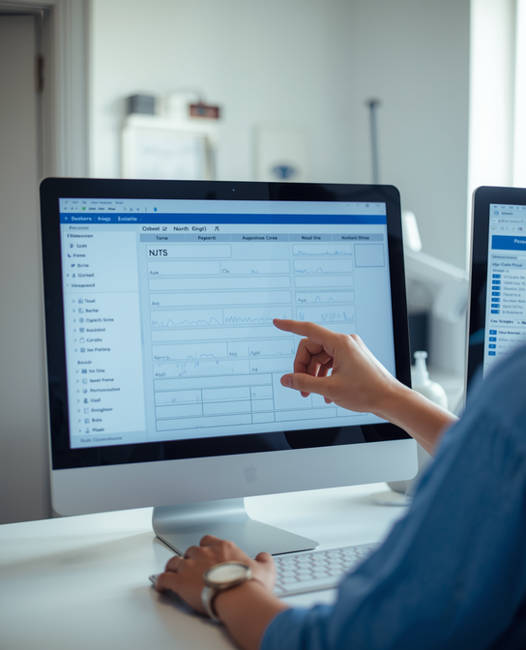
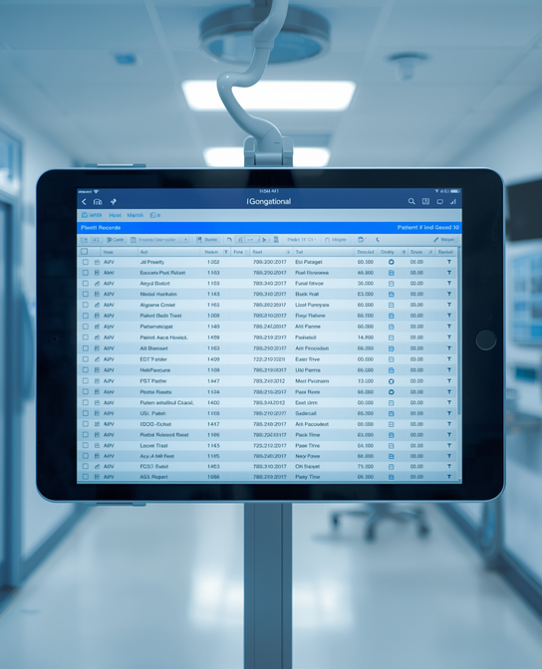



Key Features
Add Patient
Display Patients
Search Patient
Update & Health Check

Slide 5
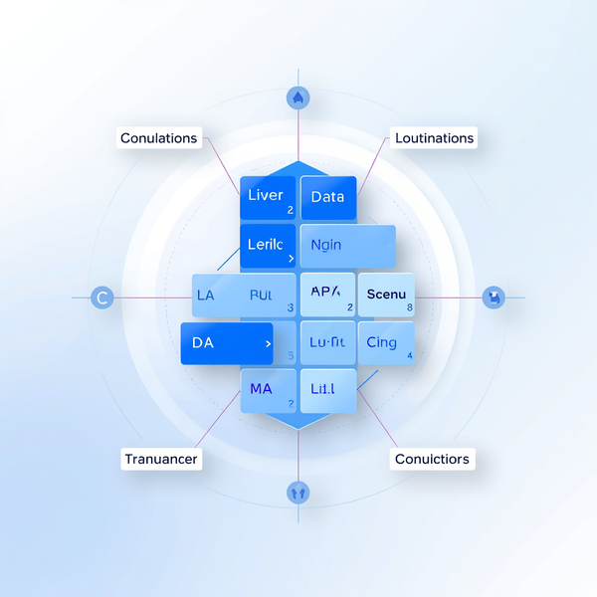

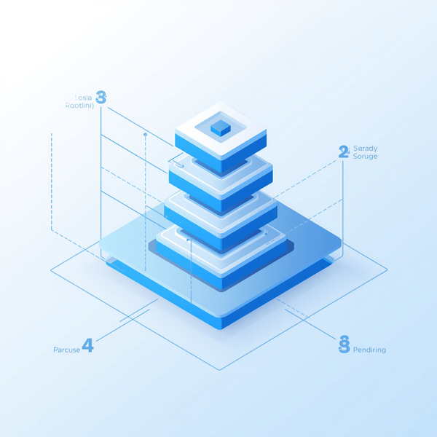
System Design – Data Structure
struct Patient with fields: id, name, age, temp, heartRate, BP
Data stored in array of Patient structures
Maximum patient limit predefined in system

Slide 6



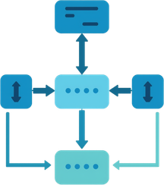

Program Flow
Menu-Driven Operation:
01
Display Menu:
Show Options
Get Input
Run Function
Repeat/Exit
02
Execute Function: Run add/display/search/update/check
03
Loop Control: Menu repeats until user selects exit

Slide 7




Health Analysis Logic
Temperature: >37.5°C = Fever
Heart Rate: <60 or >100 = Abnormal
Blood Pressure: ≥140/90 = High BP

Slide 8


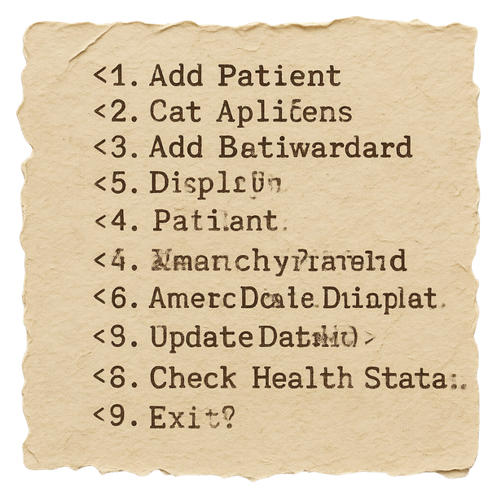
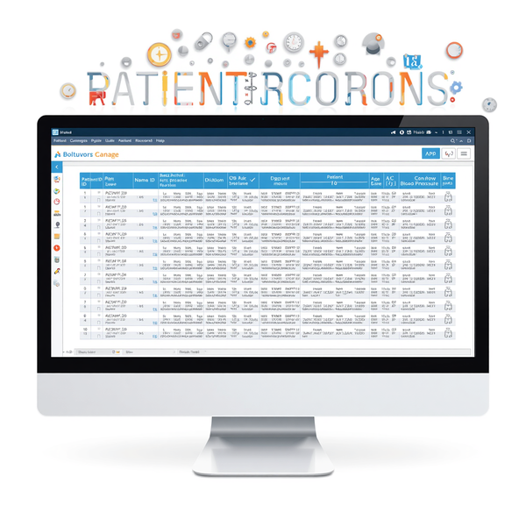
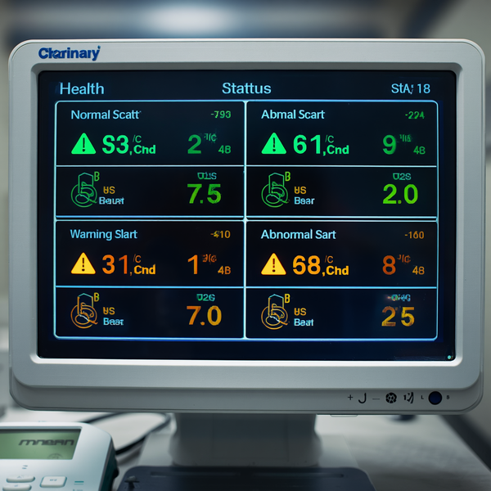


Sample Output
Menu prompt displaying options for user selection
Patient record listing with ID, name, and vitals
Health status messages showing Normal or Abnormal flags

Slide 9
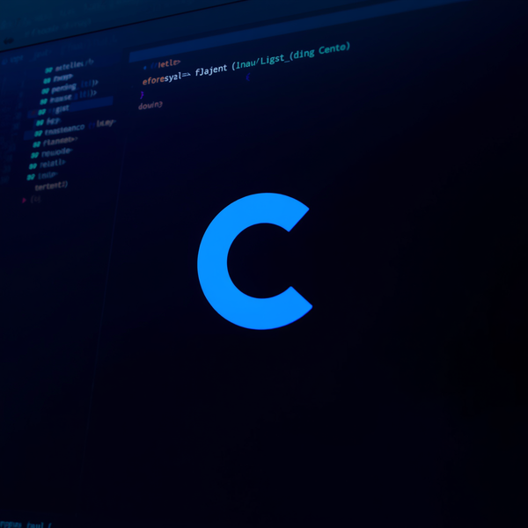

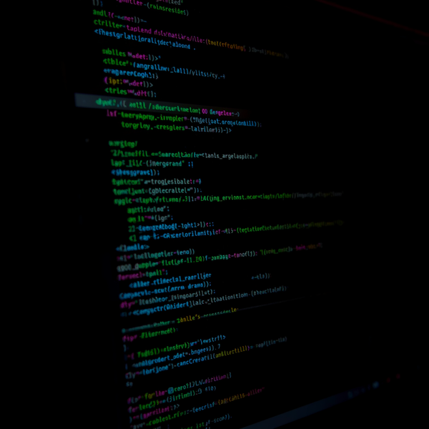
Technologies Used
C Programming Language
stdio.h & string.h Libraries
GCC Compiler & Terminal

Slide 10




Advantages
Easy to use with simple menu interface
Demonstrates important C programming concepts
Can be extended for real healthcare applications

Slide 11




Limitations
No permanent data storage (no file handling)
Limited patient capacity in memory
Basic health analysis only (no advanced metrics)

Slide 12
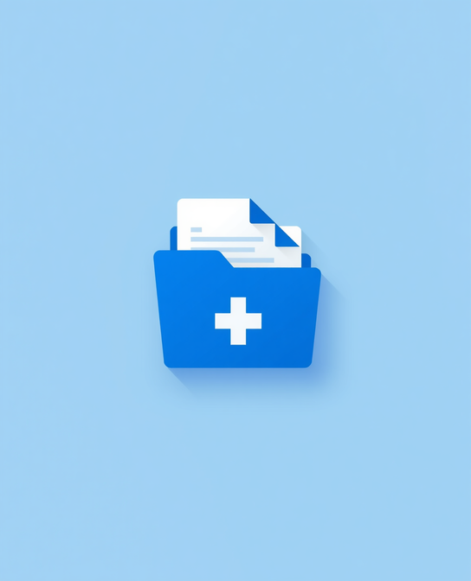

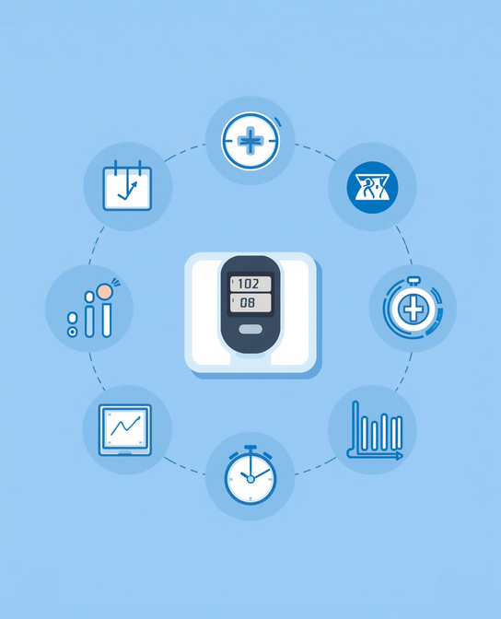

Future Enhancements
File Handling for Permanent Storage
GUI-Based Interface
Additional Health Metrics (BMI, O₂)
Security & Cloud Integration

Slide 13


Conclusion
Summary
Provides foundational understanding of healthcare programming concepts in C.
Potential
Useful starting point for advanced real-time health monitoring systems.

Slide 14


Healthcare Monitoring System
Thankyou for being here!

